Slide 1
2021 CBHC Annual Conference: Celebrating Community Partnerships
Legislative & Policy Update

Slide 2
CBHC 2021 Legislative & Policy Update: Agenda
CBHC Team & Role
2021 Session Review
Capitol Success Updates
A Look Ahead
Q & A

Slide 3
The CBHC Team

Slide 4
The Mental Health First Aid Colorado Team
Barb Becker, PhD
Director, Mental Health First Aid Colorado
Elizabeth Larson
Mental Health First Colorado Statewide Coordinator

Slide 5
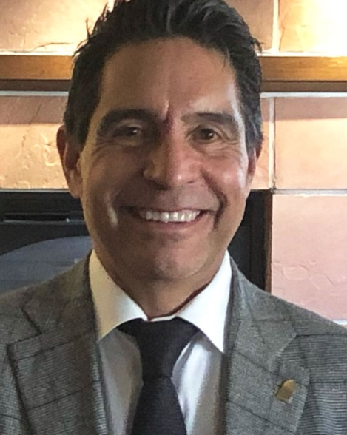
CBHC Advocacy Team
Gil Romero
Karen Wick
Principal/Attorney
Capitol Success Group
Principal Strategist
Swift Strategies

Slide 6
CBHC Role
Supporting community resilience, guiding behavioral health innovation, and partnering to enhance individual wellbeing throughout Colorado.
We do this work to improve the lives of the individuals and communities our members serve.
Policy & Priority Development
Legislative Advocacy
Budget Advocacy
Regulatory Advocacy
Education & Facilitation

Slide 7
2021 Legislative Review

Slide 8
What a Difference a Year Makes
20/21 State Budget:
JBC slashes budget to cover $3.3B shortfall
$20M+ came from community behavioral health programs
21/22 State Budget:
Unanticipated state tax revenue results in significant one-time spend
Improved economic forecast allows Governor Polis to propose a budget that restores many of the cuts from the previous year
American Rescue Plan Act (ARPA) brings $3.8B to state and $2.2B to cities and counties

Slide 9
A Big Year for Behavioral Health Policy
HB21-1097: Establish Behavioral Health Administration
SB21-154: Implement 9-8-8 in Colorado
SB21-137: Behavioral Health Recovery Act
HB21-1258: Rapid Mental Health Response for Colorado Youth
HB21-1085: Secure Transportation Behavioral Health Crisis
HB21-1030: Expand Peace Officers Mental Health Grant Program
HB21-1281: Disaster Behavioral Health Preparedness and Response Program

Slide 10
2021 Community Behavioral Health Champions
Rep. Lisa Cutter
Rep. Leslie Herod
Rep. Perry Will

Slide 11
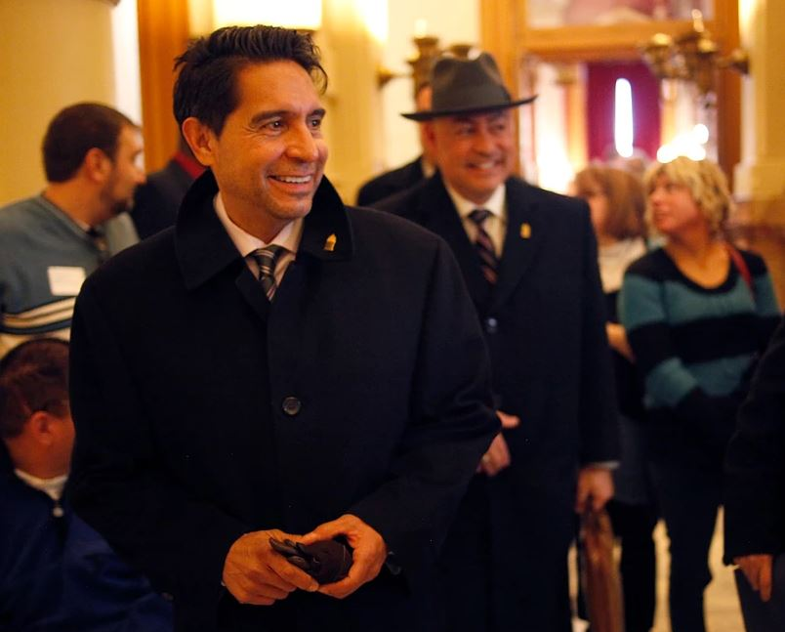
Capitol Success – Budget Updates

Slide 12
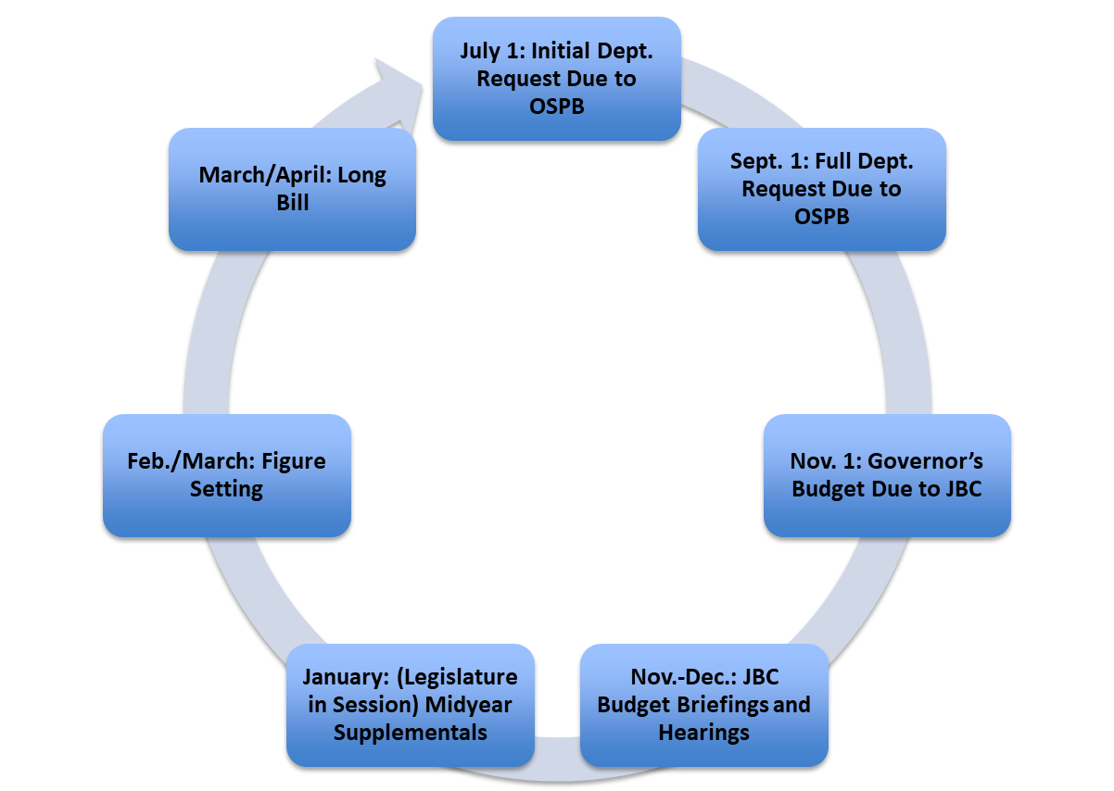
Colorado’s Budget Cycle

Slide 13
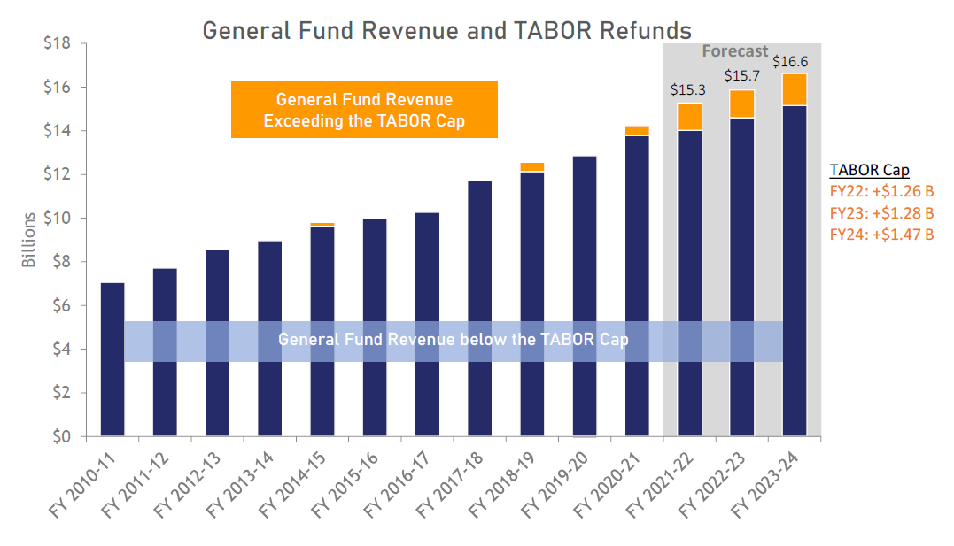
General Fund Revenue & TABOR Refunds

Slide 14
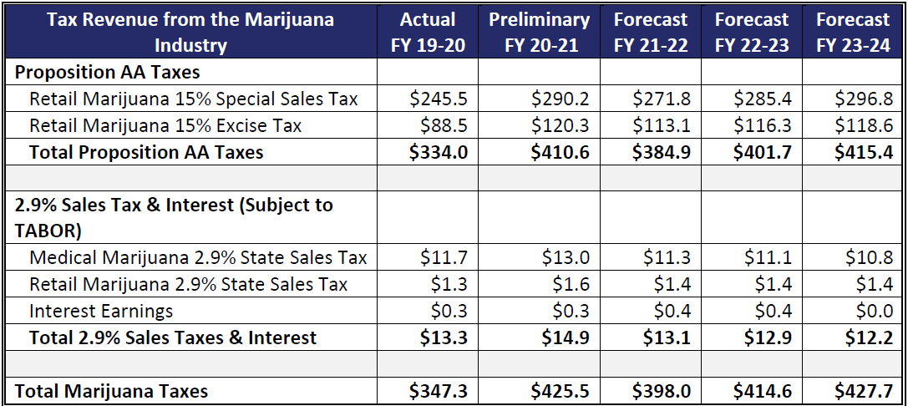
Marijuana Tax Revenue

Slide 15
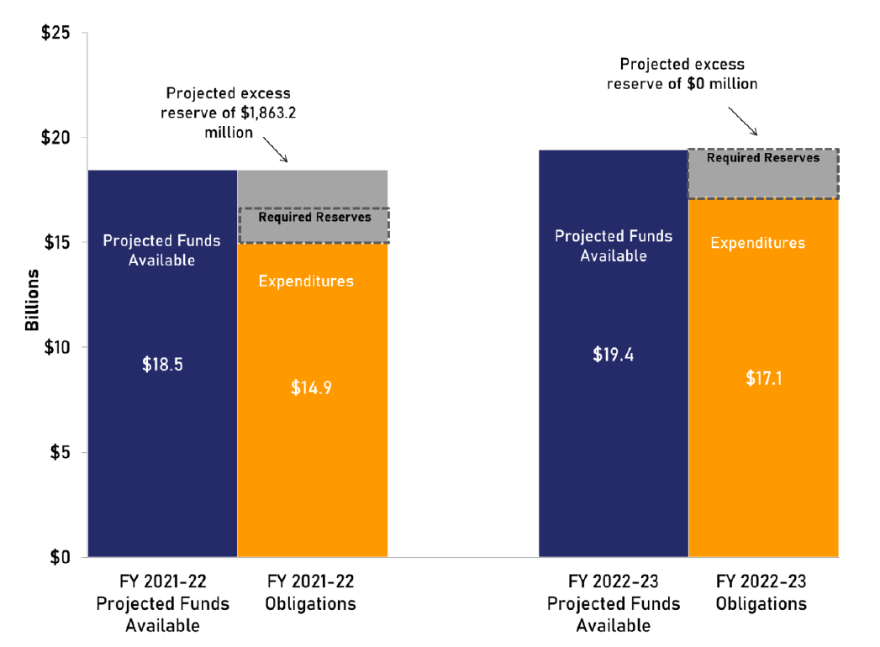
Budget Outlook

Slide 16
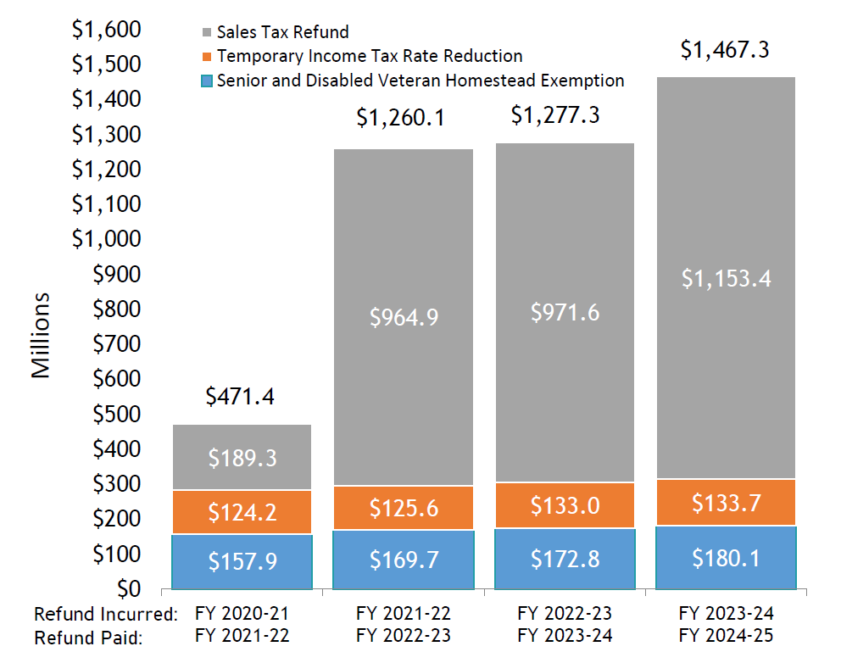
TABOR Outlook

Slide 17
ARPA & A Look Ahead

Slide 18
Impact of ARPA Funding on Behavioral Health
Transfer of $550M from state ARPA Fund to Behavioral & Mental Health Fund
$99.3M appropriated in House amendments to SB21-137
Urgent needs and system supports
Behavioral health workforce supports
Capacity and system expansion
Interim Legislative Task Force on Behavioral Health
Will make recommendations on remaining $450M+ in the Fund
16 members of the General Assembly, plus state policymakers
25 members of the public appointed to a stakeholder “subpanel”
CBHC representation on subpanel and focus of advocacy

Slide 19
Behavioral Health Transformational Task Force: Six “Pillars”
Integrated and Coordinated Care
Gaps in Care Across the Continuum
Sustainable Funding, Affordability, and Payer Systems
Criminal Justice Reform and Care
Children and Youth
Workforce

Slide 20
2022 Policy Platform Preview
Addressing Colorado’s Behavioral Health Workforce Crisis
Advancing the CCBHC Model in Colorado
Advocating for CBHC Values in the 2022 BHA Bill and Other System Reform Efforts
Reducing Administrative Burden for Safety Net Providers

Slide 21
On the Horizon
Governors’ 2022-2023 Budget: November 1
Colorado’s Redistricting Process – final maps:
December 15 (Congressional Maps)
December 29 (Legislative Maps)
2022 Legislative Session: January 12 – May 11
Primary Election Day: June 28
Election Day: November 8

Slide 22
CCBHC: Achieving Nationwide Expansion and Adoption
Fulfilling the Promise of 988
Curbing the Substance Use Epidemic
Workforce Shortage in America: Discussing Innovative Solutions and Areas of Opportunity
Notes:
Our Legislative Priorities
CCBHC: Achieving Nationwide Expansion and Adoption
Over the last 18 months, Certified Community Behavioral Health Clinics (CCBHCs) have expanded to more than 430 clinics in more than 40 states. At Hill Day at Home 2021, hundreds of advocates will be urging their legislators to support the Excellence in Mental Health and Addiction Treatment Act (H.R. 4323/S. 2069). This legislation would allow any state or territory the option to participate in the CCBHC demonstration program and authorizes the continued allocation of Substance Abuse and Mental Health Services Administration CCBHC Expansion Grants.
CCBHCs expand access to care. They provide 24/7 crisis services; they divert people from costly emergency room visits and partner with law enforcement to alleviate the burden of responding to mental health-related crisis calls. The provide expanded access to medication-assisted treatment and also help address the mental health workforce shortage – on average, clinics hire more than 40 new positions after adopting the CCBHC model.
This session will focus on the success of the CCBHC model, the impact it is having in communities across the country, and next steps on how to achieve widespread support for CCBHCs and funding for this critical program.
Fulfilling the Promise of 988
In July 2022, the National Suicide Prevention Lifeline, the nation’s main connection point to suicide prevention, mental health and substance use crisis response services, will officially transition to a new three-digit dialing code (9-8-8) for the National Suicide Prevention Lifeline. Today, states and communities are transitioning systems to better serve this vulnerable patient population when they experience a crisis. Advocates will take action to fulfill the promise of 9-8-8 so that everyone, everywhere can have access to high-quality mental health and substance use crisis services, when and where they need it them.
There is a series of legislative proposals before Congress that support the crisis care continuum that we look forward to supporting and promoting at Hill Day at Home 2021:
Authorization and appropriation of funds for the following:
National Suicide Prevention Lifeline and Lifeline Call Centers
Behavioral Health Crisis Coordinating Office
Crisis Services through the Mental Health Block Grant
Mental Health Crisis Response Partnership Pilot Program
Incentivize investments in crisis care continuum, the workforce, and capital development
Excellence in Mental Health and Addiction Treatment Act (H.R. 4323/S. 2069)
Behavioral Health Crisis Services Expansion Act (S. 1902)
Social Security/Medicaid Modifications
Funding and seeking options to extend/expand crisis care options
Clarifying the IMD prohibition to exclude psychiatric acute care crisis beds
Curbing the Substance Use Epidemic
Recent data from the Centers for Disease Control and Prevention shows the increased impact of the COVID-19 pandemic on mental wellbeing. Over the last year, more than 93,000 people in the United States died from a drug overdose, a 29.4% increase from 2019 with every state seeing significant increases. According to the Bureau of Justice Statistics, individuals reentering society after incarceration are 129 times more likely than the general population to die of a drug overdose during the first two weeks post-release. Advocates will take action on legislative proposals that would aim to curb our nation’s growing substance use epidemic by expanding access to Medication-Assisted Treatment and bolstering health care services for justice-involved individuals. This legislation includes: the Mainstreaming Addiction Treatment Act (H.R. 1384/S. 445) the Medication Access and Training Expansion (MATE) Act (H.R. 2067/ S. 2235) and the Medicaid Reentry Act (H.R. 955/S. 285).
Workforce Shortage in America: Discussing Innovative Solutions and Areas of Opportunity
The mental health and substance use workforce shortage has been exacerbated by the COVID-19 pandemic as demand for services has skyrocketed while providers struggle to meet the need. These concerns are not new: according to recent data, approximately 77 million people live in a mental health professional shortage area with 30 million living in rural counties where access to mental health and substance use treatment is completely unavailable. Take action on federal solutions being considered by Congress including the Mental Health Access Improvement Act (H.R. 432/S. 828) and the Promoting Effective and Empowering Recovery Services in Medicare (PEERS) Act (H.R. 2767/S. 2144).

Slide 23
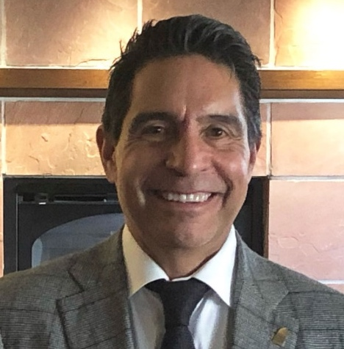
How to get in touch
Doyle Forrestal
Frank Cornelia
Gil Romero
Karen Wick
CBHC CEO
CBHC Deputy Director & Chief Strategy Officer
Capitol Success Group
Swift Strategies
dforrestal@cbhc.org 303-885-4097
Gil@capitolsuccessgroup.com 303-921-8630
Karen@swift-strategies.com 720-435-3885
fcornelia@cbhc.org 720-454-5740

Slide 24
Thank You!

